Slide 1
West Yorkshire Association of Acute Trusts
NHS Providers Webinar - Lessons learned and challenges ahead for provider collaboratives at scale

Slide 2
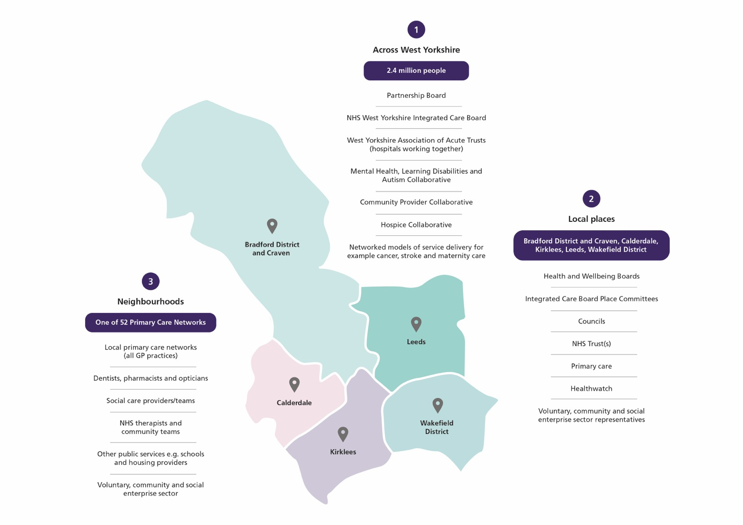

Slide 3
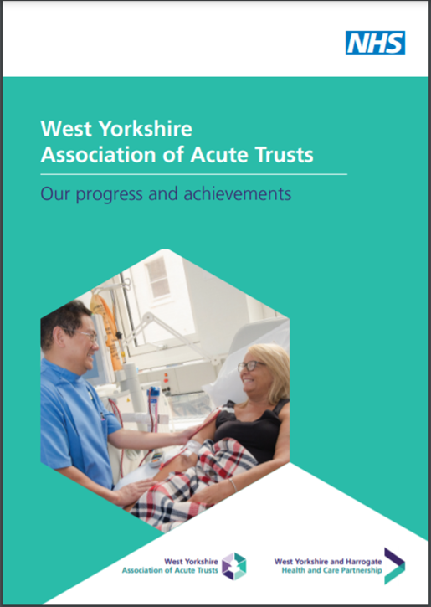
What is WYAAT?
Collaboration of six acute trusts in West Yorkshire & Harrogate
Part of the West Yorkshire Health and Care Partnership
Only what the trusts do together and the decisions they take together
Not an organisation
Not “doing things to” the trusts
Provides:
Forum for acute trusts in WY&H; a single voice into the HCP
Delivery of acute trust focussed change programmes
Facilitates clinical, operational collaboration & mutual aid

Slide 4

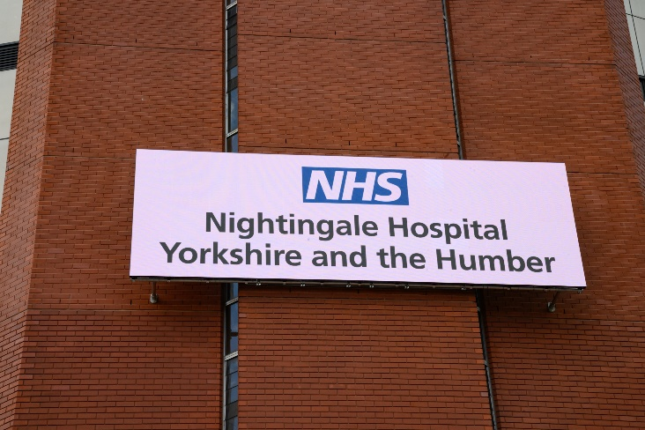

What have we achieved?
Vascular:
  Single WY vascular service
  Reconfiguration from 3 to 2 arterial centres
  New clinical model reducing admissions and length of stay
Stroke:
  Reconfiguration of Hyper Acute Stroke Services
Radiology:
  Implemented a single PACS system with image and report sharing across all trusts.
  Common scanning protocols.
  Reducing repeat scanning and manual image sharing
Pathology:
  Single laboratory information system (LIMS) and orders/results system (ICE).
  To reduce clinical variation, increase visibility of results and reduce costs.
COVID-19:
  Nightingale Hospital Y&H
  WYH PPE system
  Pathology testing
  Operational escalation and mutual aid
  Consistent approach to workforce issues

Slide 5
What makes WYAAT work?
Shared vision and common purpose
Collaborative, shared leadership
Collaboration of the willing and voluntary involvement
Well resourced PMO
Effective governance
Networks of Executive Directors and Clinical Leads

Slide 6

Looking ahead - ICS and Place
Acute provider collaboration at scale
Workforce
Fragile services
Imaging, diagnostics
Economies of scale
Cross sector collaboration locally
Non-elective flow
Urgent and emergency care
Public health, health promotion
Notes:
This slide is to make the point that at scale working is important but not everything is about scale and ICS level working – place remains central to many major NHS operational challenges.
On place:
If System Flow and non-elective demand is our biggest operational challenge then this is something which needs resourcing and solving at a Leeds level and with Leeds partners. In an ICS of 2.8m people, based on these stats it doesn’t make much sense to try and tackle these non-elective issues at a WY level.
92% of A&E activity is for Leeds residents
79% of our non-elective (including A&E) costs for adults are on Leeds residents (the remaining 21% will be WY plus rest of UK)
At the most recent audit (23/3) of no reasons to reside, of 264 NR2R patients only 14 were Pathways non-Leeds residents, 250 Leeds residents

